Slide 1


How to stay healthy, cope, and even thrive during a pandemic
Marcie Hamrick, MD
Lindsay Leeder, ARNP
Cheridan Bryant, Whole Health Coach

Slide 2



Introductions
Lindsay Leeder, ARNP
Clinical Consultant
Marcie Hamrick,
Lead Physician
Cheridan
Bryant,
Health & Wellness Coach

Slide 3

SARS-Coronavirus-2
A novel coronavirus strain, but not a new virus

Slide 4

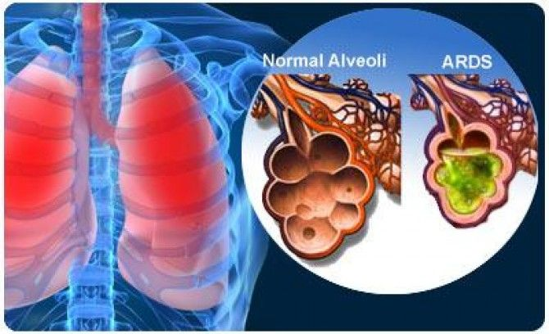
Covid-19 : Symptoms
Mild
Moderate
Severe
What is it?
What is it?
What is it?
No symptoms
Fever
Fatigue
Mild cough
Muscle aches
Loss of appetite
Cough
Shortness of Breath
Impacts function
Difficulty breathing
Chest pain
High fever
Inability to hydrate or
care for self
What is it?
Notes:
What is it?
How does it spread?
What are the symptoms
How can I prevent and manage?
This is the virus
This is how it spreads
Symptoms and management
Prevention

Slide 5

Covid-19
How is it spreading?
How do I manage?
What is it?
What is it?
We are still learning about transmission, duration
and immunity
Primarily droplet (cough, sneeze) transmission
Lives on surfaces hours to days
Risks: Close contact and exchange of saliva, nasal secretions, eye secretions
Prevention:
Hygiene and distancing
Cloth face coverings in public
Mild Cases:
Rest, manage fever, hydrate, isolate
Moderate to Severe Cases:
Seek care for evaluation
and management to include respiratory and hydration support
Notes:
What is it?
How does it spread?
What are the symptoms
How can I prevent and manage?
This is the virus
This is how it spreads
Symptoms and management
Prevention

Slide 6
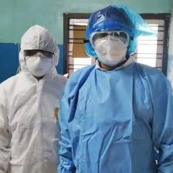
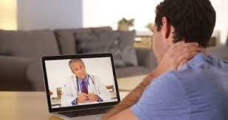
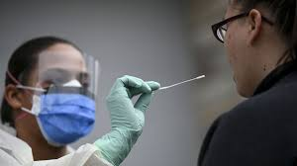
Covid-19: Getting advice
What to expect
What is it?
What can I expect when
I go in to be evaluated?
Long wait times
Personal protective equipment (PPE)
Clinical Isolation
Testing options
Decision about testing
Notes:
When to know when to be seen (2-3 min)
How to address symptoms and when is it appropriate to go to clinic
Acknowledge the desire for COVID confirmation, weigh against risk of being seen (you do not always need to go in to be seen)
When to be worried, what are red flags (2 min)
What you can expect when being seen (3-4 min)
In person experience of screening and examination
Telehealth experience of screening and management

Slide 7
Worries & Stressors
Notes:
The powers of naming your fear

Slide 8
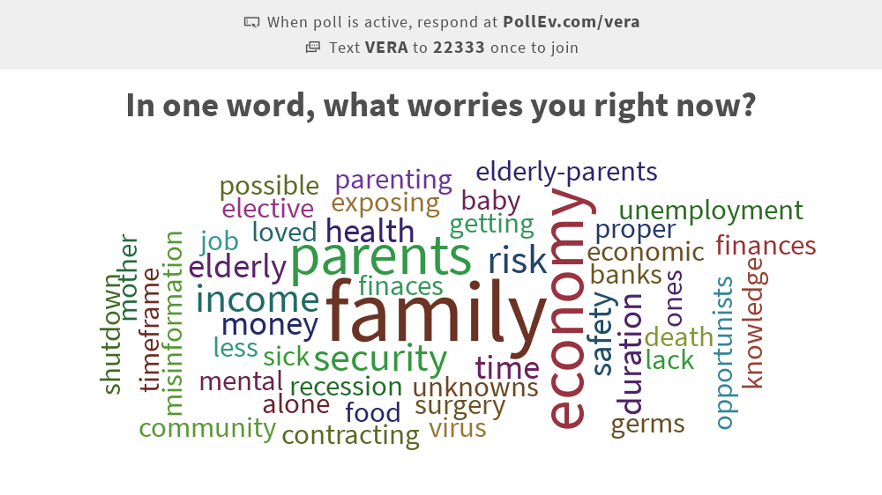

Slide 9
There is power in naming
Notes:
Name it
Understand it
Risk factors
Community
Resources
Name fears and stressors
Discuss risk factors for increased stress
Name it
How do you know you are stressed?
Less patience
Crying more easily
Physical pain
Difficulty sleeping
Increase or decrease in appetite
Increase drinking or other substance use

Slide 10
Whole Health at Home
Physical
Emotional
Social
Notes:
What does your healthy look like?
At Vera we look at the WHOLE person. Today we will spend time time diving into three dimensions of health : Social, emotional, and physical. While we are going over them separately it’s important to remember they overlap and by doing something for one you are actually contributing to the others

Slide 11


Social Health
Healthy Reciprocity
Who are your people?
What is helpful to discuss?
CC BY-SA-NC
Mindful Connection
What does connection look like right now?
What are my boundaries and what brings me energy?
It’s OK to Take Space & Check in with Yourself
Set a Routine
CC BY
Notes:
Social Health – Cheridan
Surround with a healthy connection
Understanding who you can “vent” to who won’t spiral with you or make you feel bad about how you feel.
Stay connected with loved ones – regular phone calls, social hours, video chat, letter, emails
Be mindful of social media and what you choose to invest your time in – is it filling your cup or draining your cup?
Sometimes there is too much connection – being isolated but not alone. Asking for alone time.
Allow space for creative energy – create games, projects,

Slide 12
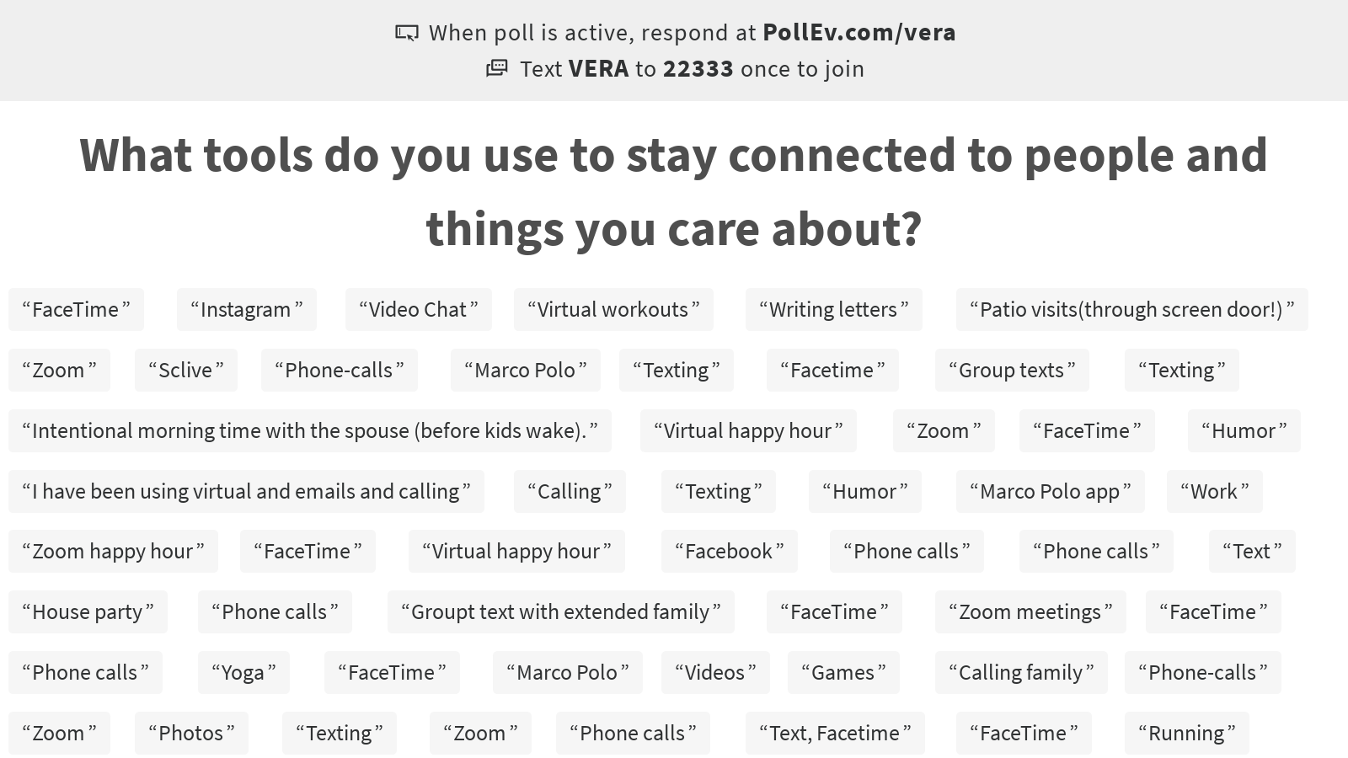
Notes:
Poll Title: What tools do you use to stay connected to people and things you care about?

Slide 13
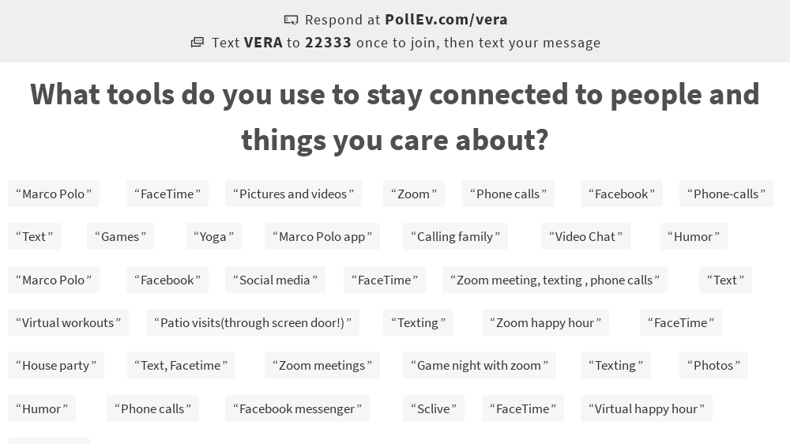

Slide 14
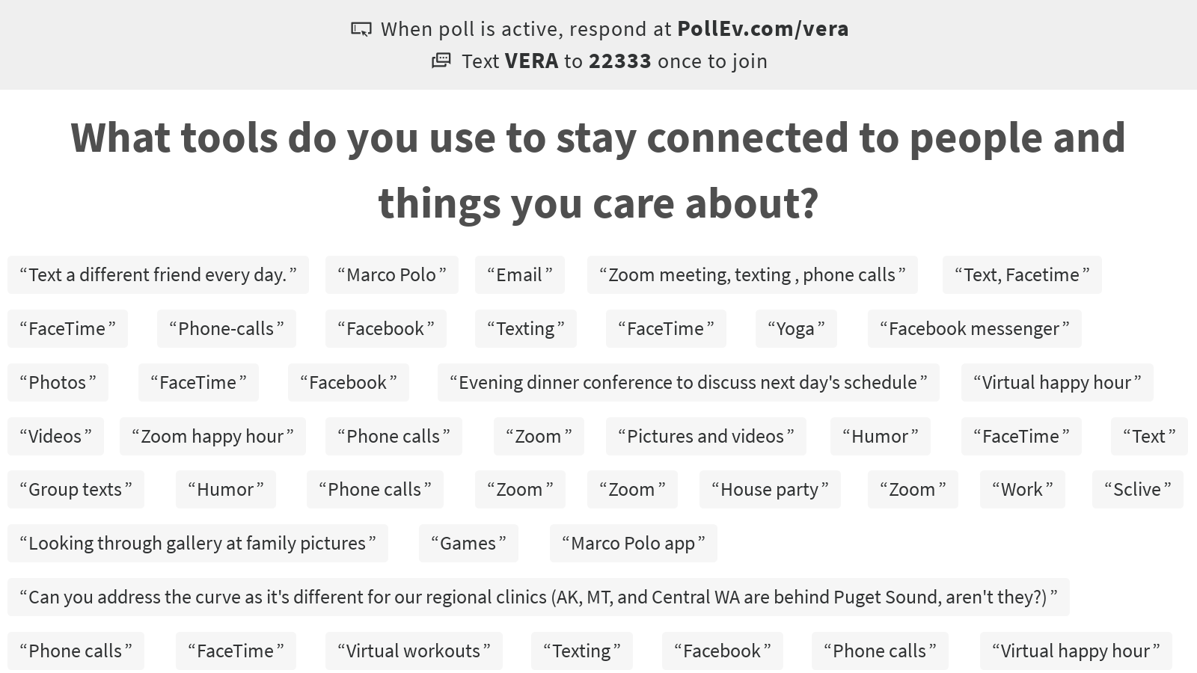
Notes:
Poll Title: What tools do you use to stay connected to people and things you care about?

Slide 15
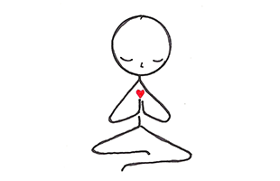
Emotional Health
Self Awareness
CC BY-NC-ND
Self Compassion
Self Care
Notes:
Self-awareness
Notice emotions and NAME them
By labeling an emotion, we can create distance between ourselves and our experience that allows us to choose how to respond to challenges
Allow self to feel what you are feeling without judgment
Recognize if the feeling is serving you are not – if it’s not ask yourself how can you let it go
It’s ok to be mad, sad, disappointment – we are human emotions are normal
Ask for help when you need it – whether it’s personal or professional
Focus on the now - WIN – What is important now – focus on current feeling and actions (John Kuypers)
Consider how you can value the current moment
Self-care – anything that energizes you mentally and physically
Invest in yourself –
Shifting perspective – look at it as an opportunity
Formal and informal mindfulness practice
Formal – meditation routine
Informal – Stop. Breathe. Observe. – taking the time to be in the present. This can be done:
Washing hands
Washing dishes
Developing a cue to anchor you’re a present moment. Example every time your phone rings or every time your child has a question about their school work take three deep breaths
How much time do you have now to do things that you’ve wanted?
Taking your commute time and changing it to self-care
Self-compassion
Be kind to yourself
Trial and correction
Remember you are not alone. This is hard

Slide 16



Physical Health
Nourish
Move
Recognize hunger
Hydrate
Get creative
Get Outside
Set goals
Partner
Rest
Routine
Rhythm
Healing
Notes:
Activity
Following state regulation but getting outside for a walk – connect with nature – garnering strength from mother earth
Movement every hour
Stretching, movement
Many local studios are offering live streaming on their website or social media accounts. Some are even free
Apps, pre-recorded videos (youtube)
Ask co-worker or family what they doing
Work out with friends or family via video chat
Always remember that something is better than nothing. You might not be able to do exactly what you want to do. It’s important to be flexible.
Reminder on phone
Eating
Nourishing your body with nutrition
You might not be able to get the food you normally would – use this as an experiment to try new things
Pay attention to snacking… why do I want a snack? Hungar? Boredom? Stressed?
Stay hydrated – pay attention to excess sugary drinks or alcohol
Boundaries – have fruit or veggies available for snack… if you are actually hungry, you’ll eat it
Physical cues: Sticky notes on fridge or computer. “Am I hungry?”
Sleep
keeping a routine – going to bed and getting up at the same time
opportunity to adjust sleep to get what our body needs. Maybe before you were getting 6 hours, but you thrive off of 7 consider adapting sleep hygiene to get the amount of sleep your body does best with
Sleep allows our bodies to heal

Slide 17
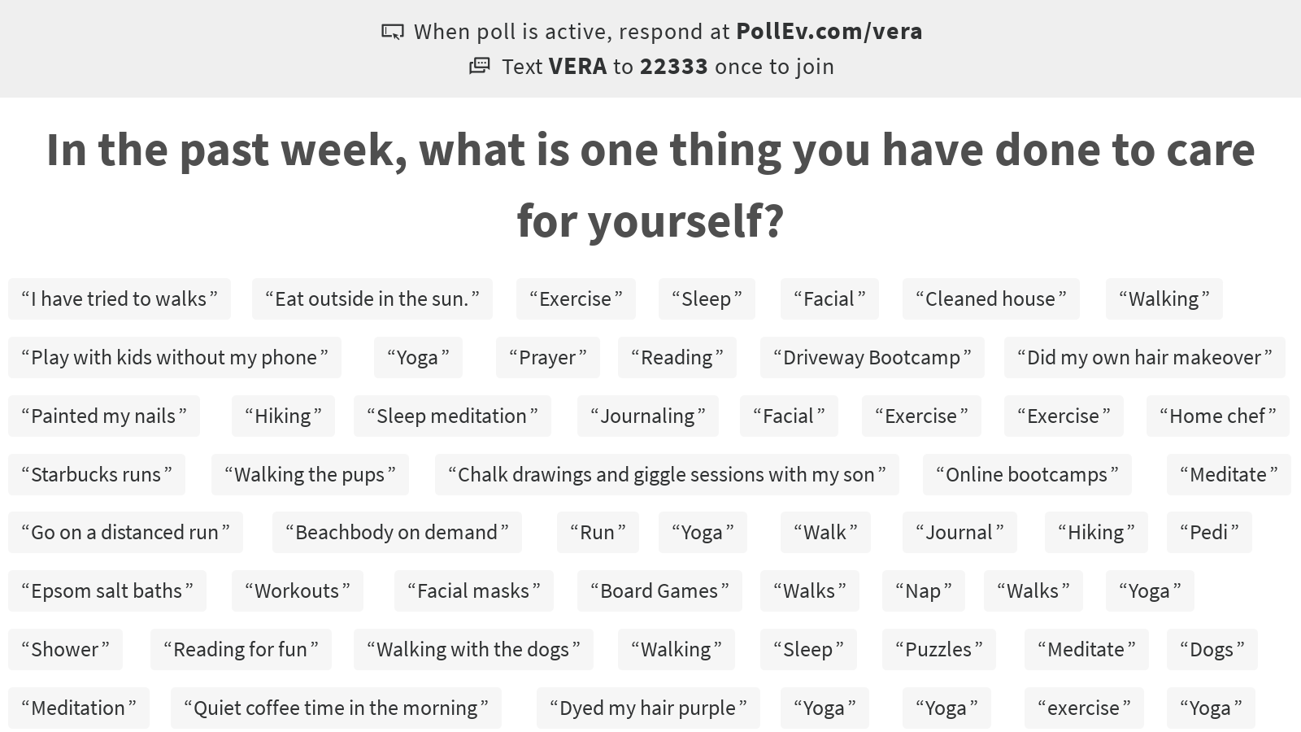
Notes:
Poll Title: In the past week, what is one thing you have done to care for yourself?

Slide 18
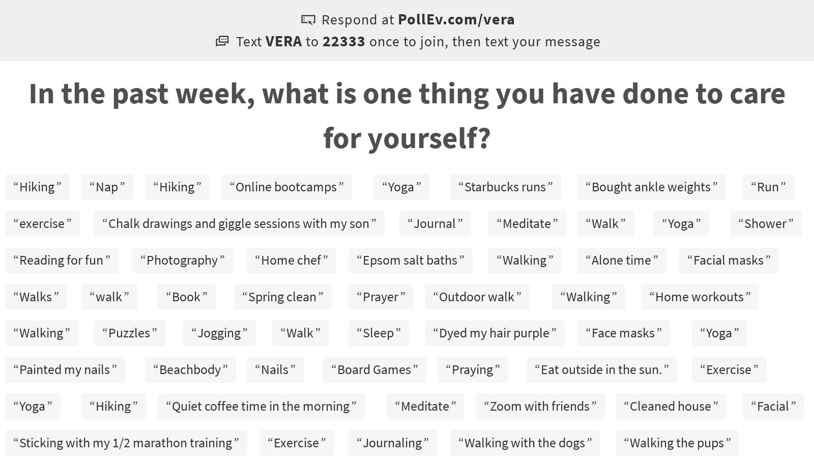
Notes:
Poll Title: In the past week, what is one thing you have done to care for yourself?

Slide 19
Stop and ask yourself, where is my attention? (pause)
Notice, is it on a thought? (pause)
Is it in the past? (pause)
Is in the present? (pause)
Gather your attention inward and place it on your breath
We’ll pause for 15 seconds (after 15 seconds)
Take one last deep breath and when you’re ready, open your eyes
Mindfulness Moment
Notes:
Name it
Understand it
Risk factors
Community
Resources
Name fears and stressors
Discuss risk factors for increased stress
Name it
How do you know you are stressed?
Less patience
Crying more easily
Physical pain
Difficulty sleeping
Increase or decrease in appetite
Increase drinking or other substance use

Slide 20
Complete the following sentences
Today, I feel….
Today, I thrive by….
Today, I commit to...

Slide 21
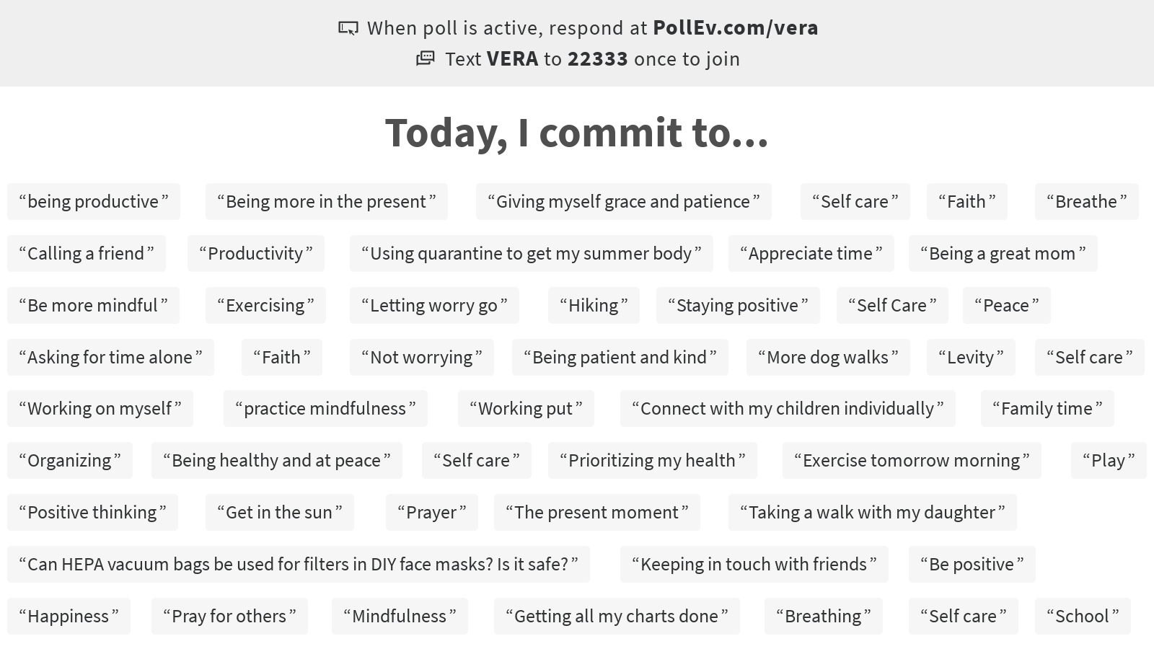
Notes:
Poll Title: Today, I commit to...

Slide 22
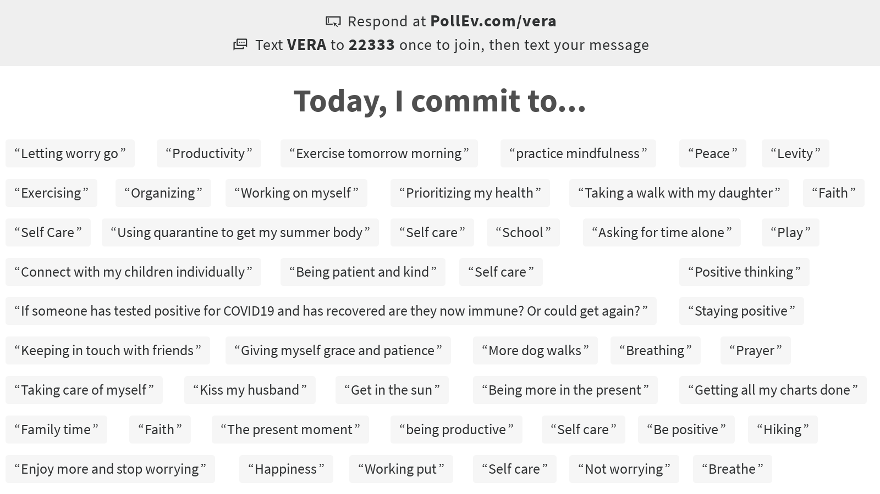
Notes:
Poll Title: Today, I commit to...

Slide 23
Resources
Cooking | Meditation | Yoga | Exercise
Cookbooks and magazines | Box breathing | Check out local studios for online offerings | Use your neighborhood block as a track
Google search: “easy healthy recipes” | Various Apps: Calm Insight Timer Headspace | YouTube: Search: gentle/ restorative yoga Yoga with Adriene | Climb hills or stairs
Website examples: Eatingwell.com Allrecipes.com Foodnetwork.com | YouTube: Guided meditation | Down Dog App | 7-minute workout (Google or YouTube)
 | YouTube: Vera Mindfulness Moments | Other online examples: Core Power Yoga The Yoga Collective Gaia.com My Yoga Works Alo Moves | Other online examples: YMCA360.org Blink Fitness Orange Theory at home Peloton Planet Fitness Gold’s Gym YouTube Amazon Prime

Slide 24
Resources
Social | Sleep | Outdoor | Kids Activities & Resources
Write letters | Tips: Set a sleep schedule Limit daytime naps Limit screens right before sleep Write down worries | Walks in nature | Understood https://www.understood.org/en/school-learning/coronavirus-latest-updates
Email a person a day | Sleepfoundation.org | Forest bathing | Child Trends https://www.childtrends.org/
Marco Polo App | Insight Timer app (nature sounds, guided sleep meditations) | Fly a kite | Child Mind Institute https://childmind.org/
Virtual gatherings on Skype, FaceTime | Aromatherapy | Find your favorite rock on a beach | Zenomath https://zenomath.org/
 | Dodow device | Walk and listen to music or an audio book | Go Zen https://gozen.com/

Slide 25
Questions & Discussion
We would love to hear more from you! If you have any follow-up questions or ideas for future webinars, please send a message to vwhwebinars@verawholehealth.com

